Slide 1




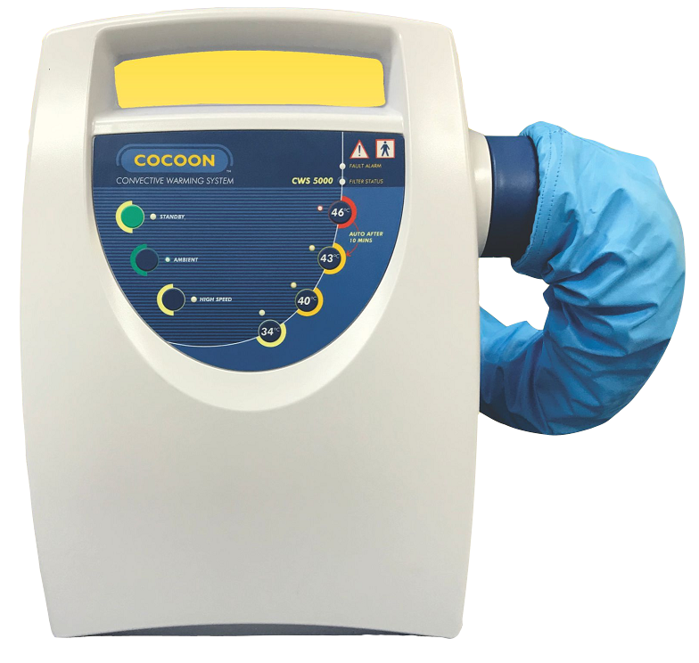








CARE ESSENTIALS
About Us
Products
Support
Contact Us
Providing the best care possible
for patients
Care Essentials continues to be a contributor to the engaging development of
innovative, high quality products for use in medical and related industries.
>
ABOUT US
COCOON
TEMPERATURE MANAGEMENT WARMING SYSTEM.
MADE IN AUSTRALIA, USED WORLDWIDE
WITH UNIQUE MICROPORE BLANKET TECHNOLOGY
ESSENTIAL CARE BEFORE,
DURING & AFTER SURGERY
>
FIND OUT MORE
Our Products
WARMING
MACHINE
WARMING
BLANKETS
SURGICAL MASKS /
RESPIRATORS
STERILISATION
WRAPS
20 Years of Industry Experience
Over 400 Customers
From major hospitals to general practice, we service the medical industry Australia-wide and 50+ countries around the world.
3 million products
We have manufacture over three million single-use medical products every year.
100+ Professional Staff
With quality our top priority, our dedicated staff have been the backbone of our business for over 40 years.
Call +61 3 5277 1455
Email sales@careessentials.com.au
Head Office
103 Mornington Street
North Geelong
VIC Australia 3215
Support
Privacy Policy
Terms & Conditions
Catalogue & Documents
CARE ESSENTIALS

Slide 2
CARE ESSENTIALS
About Us
Products
Support
Contact Us
Brands
Products
COCOON
CareGUARD
COCOON Patient Warming System
Surgical Mask
P2 Respirator
CareGUARD Sterilisation Wraps
Other >
COCOON Warming Blankets
COCOON Forced Air Warming Machine
Non-contact Infrared Thermometer
Toff Cuff Neuro-muscular Transmission
Nihon Kohden Monitoring Systems
Providing the best care possible
for patients
Providing the best care possible
for patients
Care Essentials continues to be a contributor to the engaging development of
innovative, high quality products for use in medical and related industries.
Care Essentials continues to be a contributor to the engaging development of
innovative, high quality products for use in medical and related industries.
>
>
FIND OUT MORE
ABOUT US
COCOON
TEMPERATURE MANAGEMENT WARMING SYSTEM.
MADE IN AUSTRALIA, USED WORLDWIDE
WITH UNIQUE MICROPORE BLANKET TECHNOLOGY
ESSENTIAL CARE BEFORE,
DURING & AFTER SURGERY
>
FIND OUT MORE
Our Products
WARMING
MACHINE
WARMING
BLANKETS
SURGICAL MASKS /
RESPIRATORS
STERILISATION
WRAPS
20 Years of Industry Experience
Over 400 Customers
From major hospitals to general practice, we service the medical industry Australia-wide and around the world
3 million products
We have manufacture over three million single-use medical products every year
100+ Professional Staff
With quality our top priority, our dedicated staff have been the backbone of our business for over 40 years
Call +61 3 5277 1455
Email sales@careessentials.com.au
Head Office
103 Mornington Street
North Geelong
VIC Australia 3215
Support
Privacy Policy
Terms & Conditions
Catalogue & Documents
CARE ESSENTIALS

Slide 3

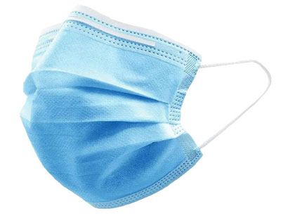

CARE ESSENTIALS
About Us
Products
Support
Contact Us
COCOON
a
Surgical &
Procedural Mask
Where quality meets value
Introducing a new generation of surgical masks, carefully designed and developed in partnership with Australian hospitals and clinical specialists to exceed clinical design requirements, raise quality and compliance standards and add value to the Healthcare system.
COCOON
Surgical & Procedural Mask
Cocoon masks are available in head-tie (Surgical) and ear-loop (Procedural) selections.
COCOON disposable masks are Australian-made and Australian certified. Order our Level 2 or Level 3 masks today.
>
ORDER TODAY
DESCRIPTION
Level 2 and Level 3 Disposable Surgical Mask
STANDARDS COMPLIANCE
AS 4381 Classification: Level 2 / Level 3 Surgical Masks
ASTM F2100 Classification: Level 2 / Level 3 Surgical Masks
TGA REGISTERED
ARTG – 339255
CARE ESSENTIALS
Privacy Policy
Privacy Policy
Head Office
103 Mornington Street
North Geelong
VIC Australia 3215
Support
Privacy Policy
Terms & Conditions
Catalogue & Documents
CARE ESSENTIALS
Call +61 3 5277 1455
Email sales@careessentials.com.au
Terms & Conditions
Terms & Conditions
Site map
Site map

Slide 4
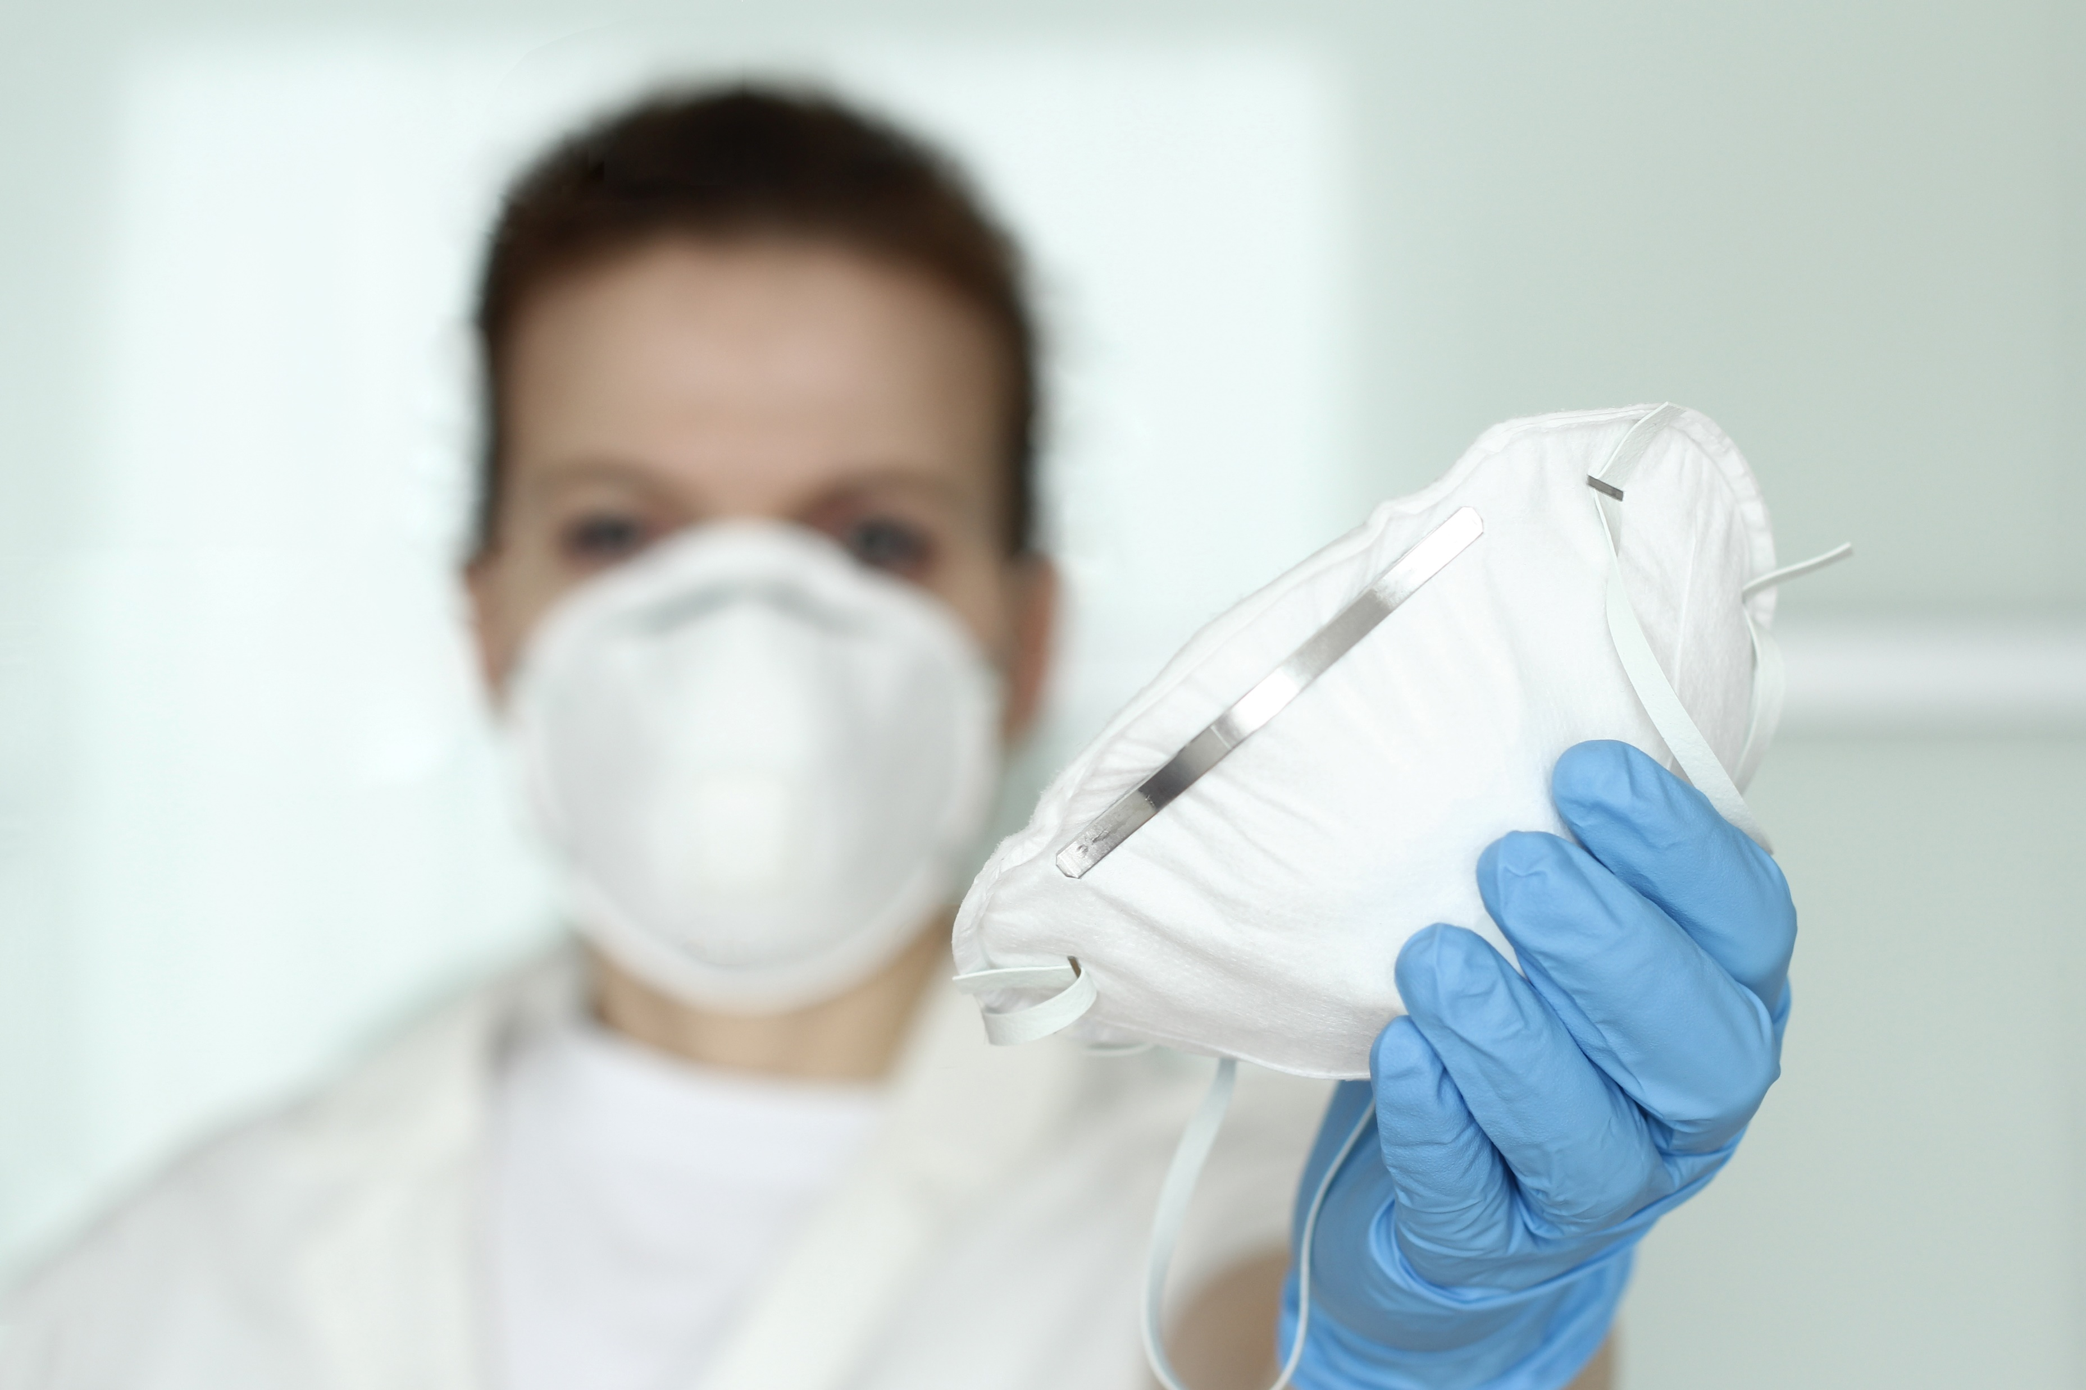
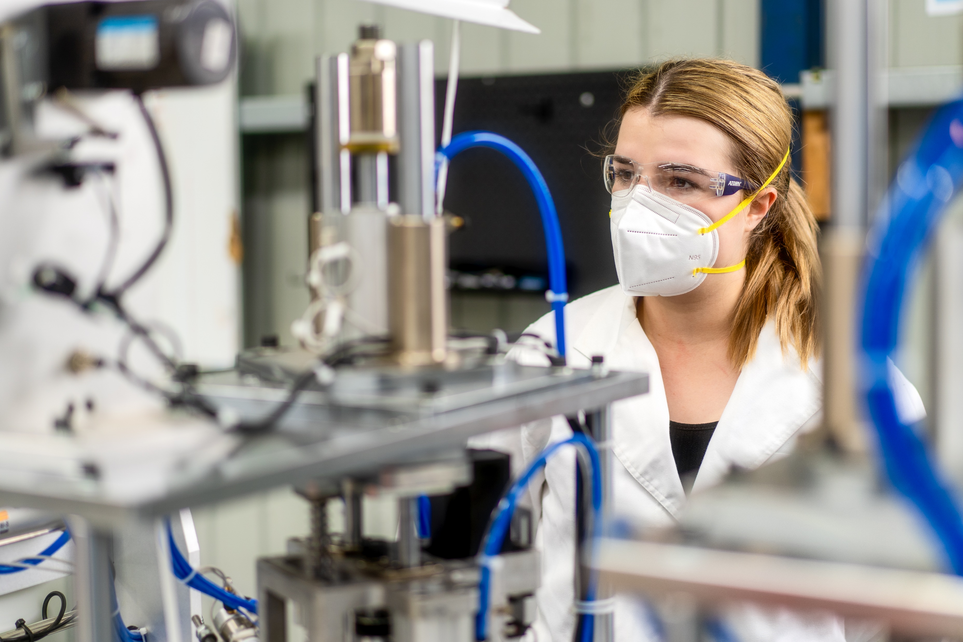
CARE ESSENTIALS
About Us
Products
Support
Contact Us
COCOON
a
N95
Respirator
Comfort and exceptional security
The Cocoon fluid resistant respirators provide a high level of respiratory protection for clinicians, patients and general users. Not only does our masks provide a secure seal and high fit results, but also delivers the ultimate comfort with a soft nose foam and breathable material.
COCOON
N95 RESPIRATOR
The Cocoon fluid resistant respirators provide a high level of respiratory protection for clinicians, patients and general users.
Our masks are Australian-made and Australian certified.
DESCRIPTION
N95 Surgical Grade Respirator / Mask
Ear loop and headband options available
STANDARDS COMPLIANCE
Tested to N95 NIOSH Standard
TGA REGISTERED
ARTG – 340518
PARTICULATE FILTER RESPIRATOR
When securely fitted, the mask establishes an effective barrier against particulate matter Particulate filtration efficiency: >95%
FLUID RESISTANCE
The fluid resistant properties of the mask deliver protection against fluid strikethrough Synthetic blood penetration resistance: 160mmHg (Level 3 Respirator)
ULTIMATE COMFORT & EXTRA SECURITY
Providing a secure seal with adjustable aluminium nose clip & headband
Comfort for the user – Soft nose foam & breathable face mask
Achieve high fit results for all face shapes
Comes in two sizes –
Regular (20/box) and Small (40/box)
CARE ESSENTIALS
Privacy Policy
Privacy Policy
Head Office
103 Mornington Street
North Geelong
VIC Australia 3215
Support
Privacy Policy
Terms & Conditions
Catalogue & Documents
CARE ESSENTIALS
Call +61 3 5277 1455
Email sales@careessentials.com.au

